Slide 1
PHYS4260 Quantum Mechanics II Spring 2025
Time Dependent Perturbation Theory

Slide 2
Outline
Sinusoidal perturbation
Floppy frequency example (I.I. Raby)
Fermi’s Golden Rule example
Absorption, Stimulated and Spontaneous Emission
Incoherent perturbations

Slide 3
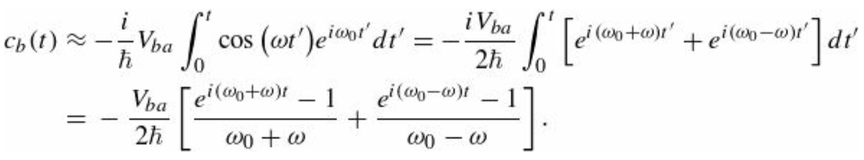
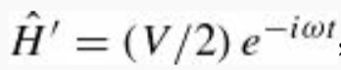
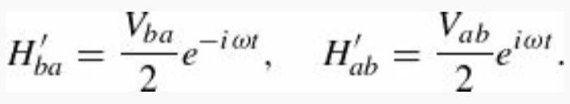
Re: The rotating wave approximation and I.I. Rabi’s flopping frequency
The first term in
comes from the $e^{iωt}/2$ part of $\cos{(ωt)}$ and the second from $e^{−iωt}/2$. Thus, dropping the first term is formally
equivalent to writing
In fact:
That is equivalent to say
The latter is required to make the Hamiltonian matrix hermitian—or, if you prefer, to pick out the dominant term in the formula analogous to the Equation above for $c_{a}(t)$.

Slide 4
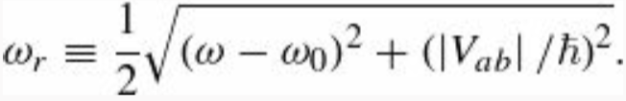
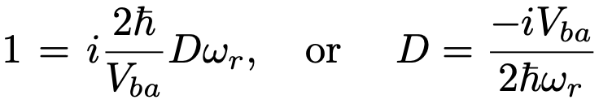
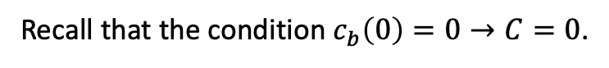
Re: The rotating wave approximation and I.I. Rabi’s flopping frequency
which allows us to calculate the coefficient $c_{a}(t)$
The condition $c_{a}\left(0\right)=1$ gives
Recall that the condition $c_{b}\left(0\right)=0→C=0$.
Finally, the complete exact solution is given as

Slide 5
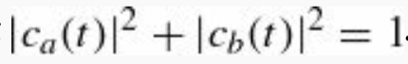
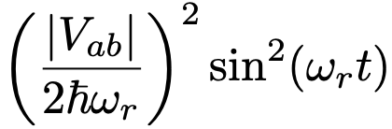
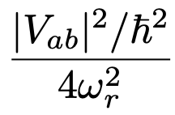
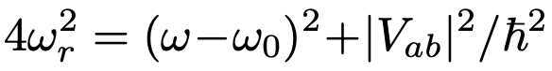
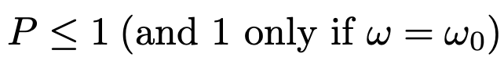
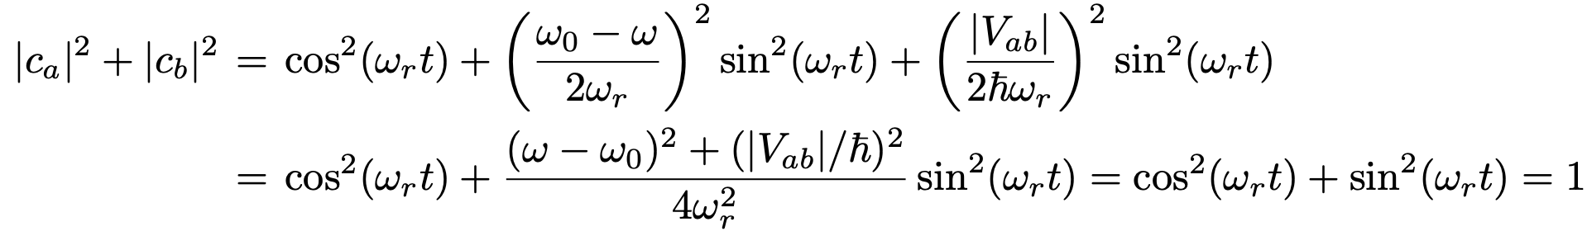
The rotating wave approximation and I.I.Rabi’s flopping frequency
Transition Probability. Now we determine the transition probability ${P(t)}_{a→b}$ and show that it never exceeds 1.
We will confirm that
which reaches its maximum when the sine is 1:
If we look at $ω_{r}$ in the denominator it always exceeds the numerator
Finally, we calculate

Slide 6
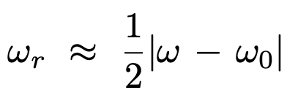
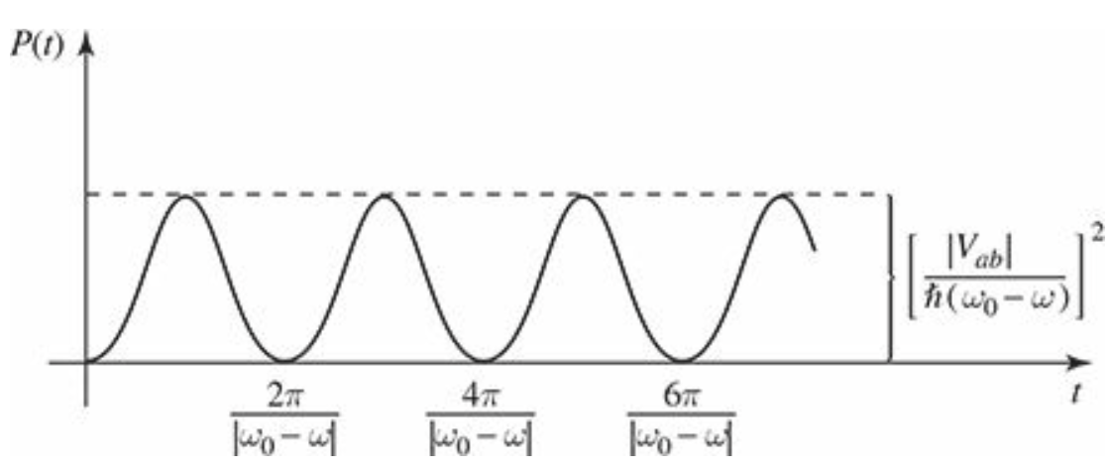
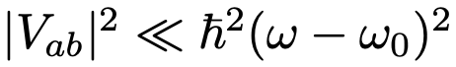
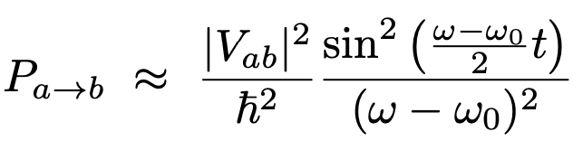
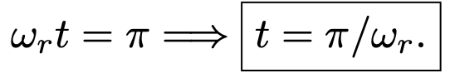
The rotating wave approximation and I.I.Rabi’s flopping frequency
We observe that ${P(t)}_{a→b}$ reduces to the perturbation theory result when the perturbation is “small”.
More specifically, in this context small means a constraint on V. In fact, if
Then
exactly as we found before
The system first return to its initial state after

Slide 7
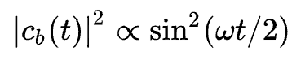
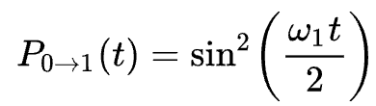
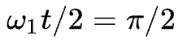
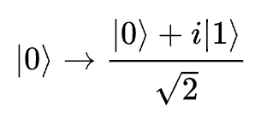
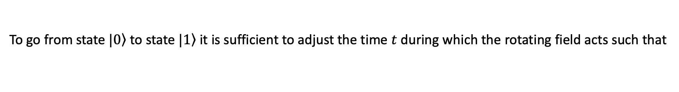
Rabi’s flopping frequency applications
Quantum optics. Rabi flopping may be used to describe a two-level atom with an excited state and a ground state in an electromagnetic field with frequency tuned to the excitation energy. Using the spin-flipping formula but applying it to this system yields
$ω$ is the Rabi frequency. Jaynes–Cummings Model (JCM) 2-level atom interacting with a quantized mode of an optical
cavity with or without the presence of light.
Quantum computing. Any two-state quantum system can be used to model a qubit. Rabi’s flopping provides a physical way to allow for spin flips in a qubit system. At resonance, the transition probability is given by
To go from state $\left.|0\right\rangle$ to state $\left.|1\right\rangle$ it is sufficient to adjust the time $t$ during which the rotating field acts such that
This is called a π pulse. If a time intermediate between 0 and π/ω1 is chosen, we obtain a superposition of
|0⟩ and |1⟩. In particular, for t = π/(2ω1), we have a π/2 pulse, which acts as
Eqns are identical in the case of a two-level
atom in the field of a laser

Slide 8
Sinusoidal Perturbations: Fermi’s Golden rule
Before we obtain this very important result, we need to refresh/use a few results from complex analysis.

Slide 9
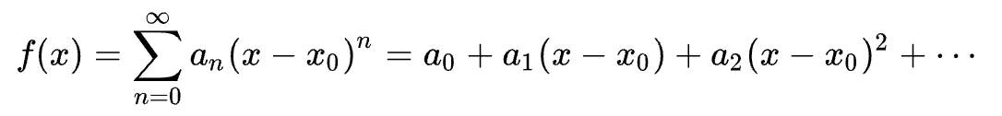
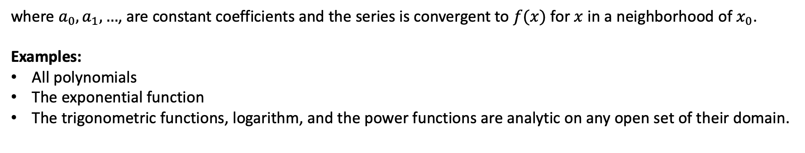
Complex Analysis refresher 1.
Analytic Functions: An analytic function is a function $f$that is locally given by a convergent power series. That is,
if and only if for every $x_{0}$ in its domain, its Taylor series about $x_{0}$ converges to the function $f(x)$ in some neighborhood of $x_{0}$.
This is stronger than merely being infinitely differentiable at $x_{0}$
where $a_{0},a_{1},…$, are constant coefficients and the series is convergent to $f(x)$ for $x$ in a neighborhood of $x_{0}$.
Examples:
All polynomials
The exponential function
The trigonometric functions, logarithm, and the power functions are analytic on any open set of their domain.

Slide 10
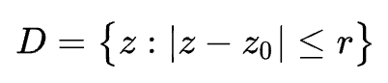
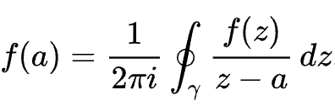
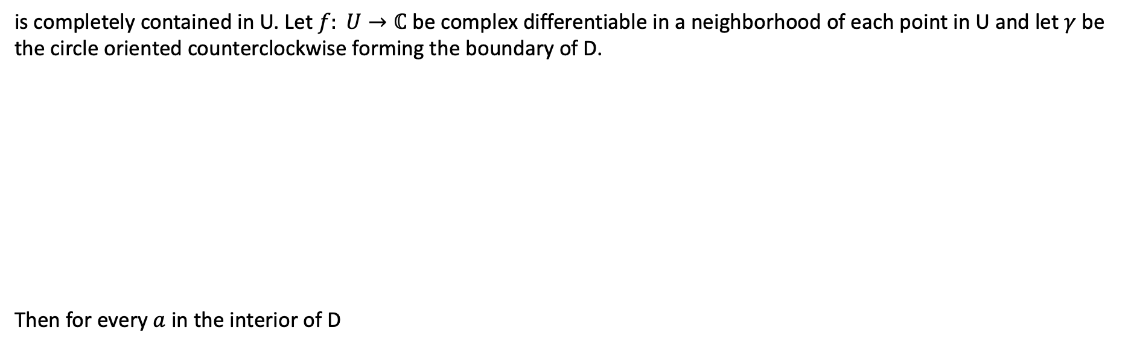
Complex Analysis refresher 2.
Cauchy-Riemann Formula: Let U be an open subset of the complex plane $ℂ$, and suppose the closed disk D defined as
is completely contained in U. Let $f: U→ℂ$ be complex differentiable in a neighborhood of each point in U and let $γ$ be
the circle oriented counterclockwise forming the boundary of D.
Then for every $a$ in the interior of D
D
U

Slide 11
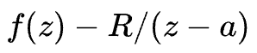
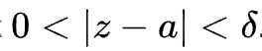
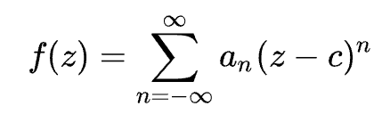
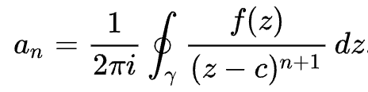
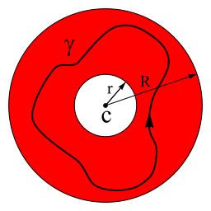
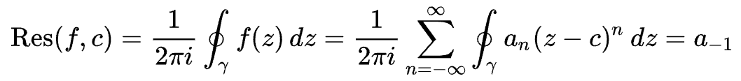

Complex Analysis refresher 3.
Residue: The residue at an isolated singularity $a,$denoted as $Res(f,a)$, of a complex function $f$ that is differentiable in
its full domain except for a set of isolated points $a_{1},a_{2},…\text{ ,} a_{n}$, (poles of the function), is the unique value $R$ such that the
integral of
exists in
Laurent series. An alternative definition can be given in terms of Laurent series. The Laurent series for a complex
function $f(z)$ about an arbitrary point $c$ is given by
where:
The residue of $f(z)$ at point $c$ is defined as

Slide 12
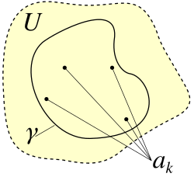
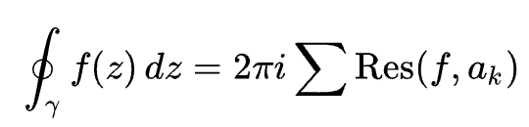
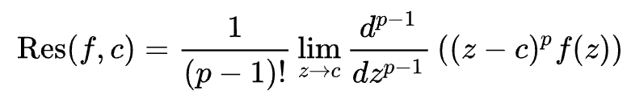
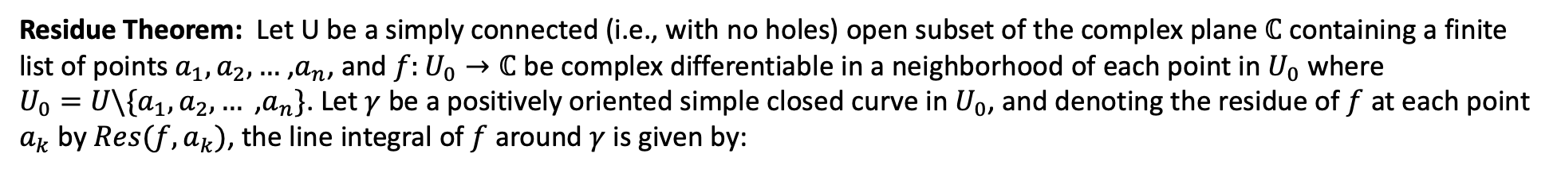
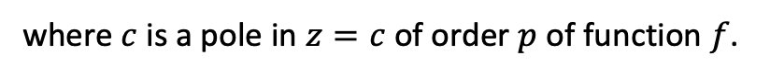
Complex Analysis refresher 4.
Residue Theorem: Let U be a simply connected (i.e., with no holes) open subset of the complex plane $ℂ$ containing a finite
list of points $a_{1},a_{2},…$ ,$a_{n}$, and $f:U_{0}→ℂ$ be complex differentiable in a neighborhood of each point in $U_{0}$ where
$U_{0}=U\backslash \{a_{1},a_{2},…\text{ ,} a_{n}\}$. Let $γ$ be a positively oriented simple closed curve in $U_{0}$, and denoting the residue of $f$ at each point
$a_{k}$ by $Res(f,a_{k})$, the line integral of $f$ around $γ$ is given by:
The more general formula for higher order poles is given by
where $c$ is a pole in $z=c$ of order $p$ of function $f$.

Slide 13
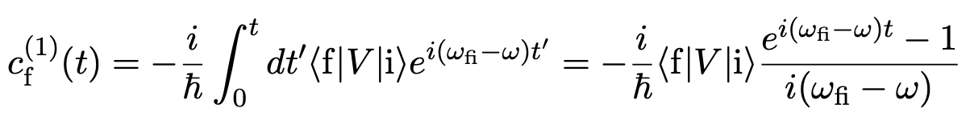
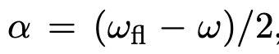
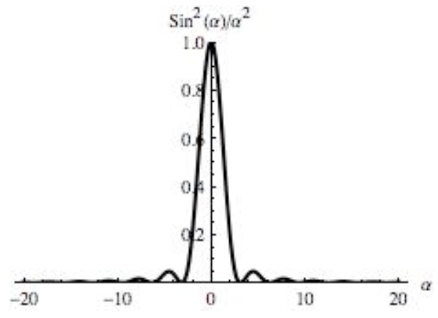
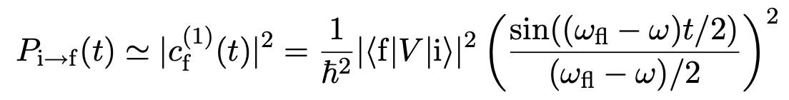
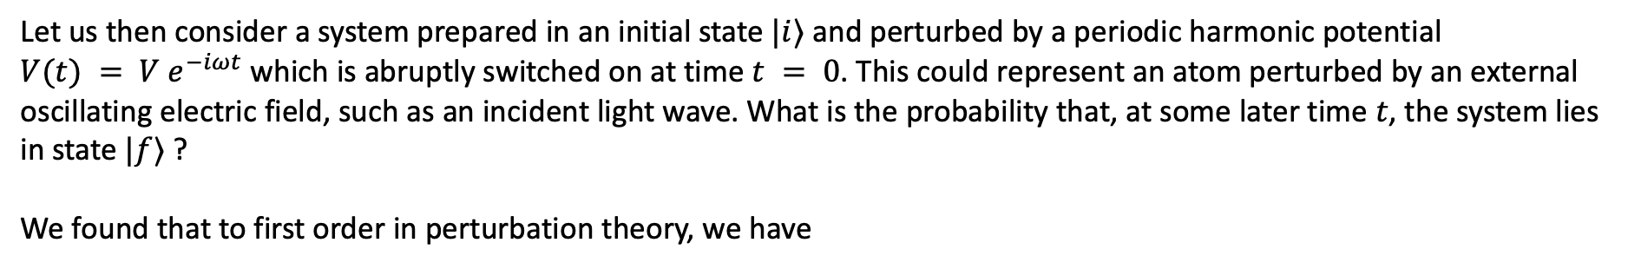
Fermi’s Golden Rule
Let us then consider a system prepared in an initial state $|i⟩$ and perturbed by a periodic harmonic potential
$V(t) = V e^{−iωt}$ which is abruptly switched on at time $t = 0$. This could represent an atom perturbed by an external oscillating electric field, such as an incident light wave. What is the probability that, at some later time $t$, the system lies in state $|f⟩$ ?
We found that to first order in perturbation theory, we have
The probability of eﬀecting the transition after a time $t$ is therefore given by
So far, so good, nothing new. But let us look at the plot for the sine function

Slide 14

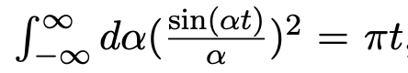
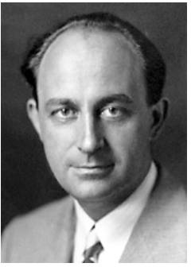
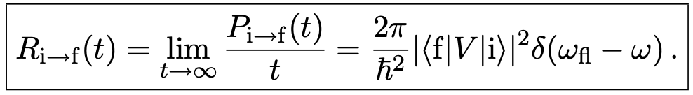
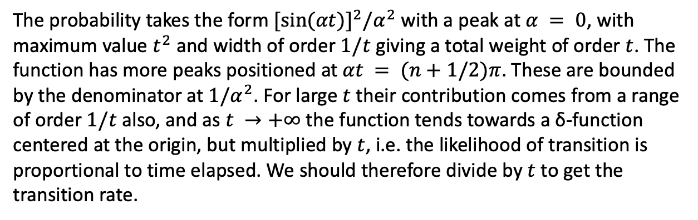
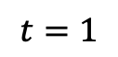
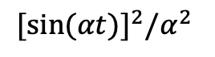
Fermi’s Golden Rule
${[sin(αt)]}^{2}⁡/α^{2}$
The probability takes the form ${[sin(αt)]}^{2}⁡/α^{2}$ with a peak at $α = 0$, with maximum value $t^{2}$ and width of order $1/t$ giving a total weight of order $t$. The function has more peaks positioned at $αt = (n+1/2)π$. These are bounded by the denominator at $1/α^{2}$. For large $t$ their contribution comes from a range of order $1/t$ also, and as $t →+∞$ the function tends towards a δ-function centered at the origin, but multiplied by $t$, i.e. the likelihood of transition is proportional to time elapsed. We should therefore divide by $t$ to get the transition rate.
$$t=1$$
Using the relation
and the Dirac delta definition in terms of the limit above
Enrico Fermi 1901-1954
the expression for the transition rate is

Slide 15
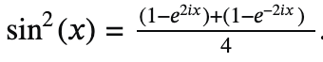





Fermi’s Golden Rule: normalization integral
All we are left to do is to prove
or
It is easy to see this by using the residue theorem. We observe that using the complex representation for sin(x)
To avoid the double pole at 𝑥=0, drop the path of integration a bit below the real line (this function has no poles, and it
vanishes at infinity, so this is okay).
Note that 𝛾+ circles the double pole at 𝑥=0 of
and 𝛾− misses the pole at 𝑥=0 of
The residue theorem gives $→$

Slide 16



Emission and Absorption of Radiation
Electromagnetic Waves
An electromagnetic wave ( “light”, though it could be infrared, ultraviolet, microwave, x-ray, etc.; these differ only in their frequencies) consists of transverse (and mutually perpendicular) oscillating electric and magnetic fields (See figure).
An atom, in the presence of a passing light wave, responds primarily to the electric component. If the wavelength is long (compared to the size of the atom), we can ignore the spatial variation in the field; the atom, then, is exposed to a sinusoidally oscillating electric field
Let’s assume the light is monochromatic and polarized along the z direction).
The perturbing Hamiltonian is
where q is the charge of the electron. Evidently

Slide 17



Electromagnetic Waves
Typically, $ψ$ is an even or odd function of z; in either case $z{\left|ψ\right|}^{2}$ is an odd function which integrates to zero (this is Laporte’s rule. This licenses our usual assumption that the diagonal matrix elements of $H^{′}$vanish.
Thus, the interaction of light with matter is governed by precisely the kind of oscillatory perturbation we studied before, with
Absorption, Stimulated Emission, and Spontaneous Emission.
If an atom starts out in the “lower” state $ψ_{a}$ and we shine a polarized monochromatic beam of light on it, the probability of a transition to the “upper” state $ψ_{b}$
In this process, the atom absorbs energy $E_{b}−E_{a}=ℏω_{0}$ from the electromagnetic field, so it’s called absorption.

Slide 18



Absorption, Stimulated and Spontaneous Emission
Informally, we say that the atom has “absorbed a photon”. Technically, the word “photon” belongs to QED
Quantum Electrodynamics—the quantum theory of the electromagnetic field—whereas we are treating the field itself classically. But this language is convenient, as long as you don’t read too much into it.
We could, of course, go back and run the whole derivation for a system that starts off in the upper state
$c_{a}\left(0\right)=0; c_{b}\left(0\right)=1$
The result will be exactly the same—except that this time we’re calculating the probability of a transition down to the lower level:
This is an absolutely astonishing result: If the particle is in the upper state, and you shine light on it, it can make a transition
to the lower state, and in fact the probability of such a transition is exactly the same as for a transition upward from
the lower state. This process, which was first predicted by Einstein, is called stimulated emission.

Slide 19


LASER (Light Amplification by Stimulated Emitted Radiation)
In the case of stimulated emission, the electromagnetic field gains energy $ℏω_{0}$ from the atom; we say that:
one photon went in, and two photons came out—the original one that caused the transition plus another one from the transition itself.
This raises the possibility of amplification, for if we had a bottle of atoms, all in the upper state, and triggered it with a single incident photon, a chain reaction would occur, with the first photon producing two, these two producing four, and so on. We’d have an enormous number of photons coming out, all with the same frequency and at virtually the same instant.
That is the principle behind the LASER (Light Amplification by Stimulated Emitted Radiation)
Note that it is essential (for laser action) to get a majority of the atoms into the upper state (a so-called population inversion), because absorption (which costs one photon) competes with stimulated emission (which creates one); if you started with an even mixture of the two states, you’d get no amplification at all.

Slide 20


Spontaneous Emission
There is a third mechanism (in addition to absorption and stimulated emission) by which radiation interacts with matter; it is called spontaneous emission. Here an atom in the excited state makes a transition downward, with the release of a photon, but without any applied electromagnetic field to initiate the process.
This is the mechanism that accounts for the normal decay of an atomic excited state. At first sight it is far from clear why spontaneous emission should occur at all. If the atom is in a stationary state (albeit an excited one), and there is no external perturbation, it should just sit there forever. And so it would, if it were really free of all external perturbations.
However, in quantum electrodynamics the fields are nonzero even in the ground state—just as the harmonic oscillator (for example) has nonzero energy ( $ℏω/2$) in its ground state.
You can turn out all the lights, and cool the room down to absolute zero, but there is still some electromagnetic radiation present, and it is this “zero point” radiation that serves to catalyze spontaneous emission. When you come right down to it, there is really no such thing as truly spontaneous emission; it’s all stimulated emission. The only distinction to be made is whether the field that does the stimulating is one that you put there, or one that God put there. In this sense it is exactly the reverse of the classical radiative process, in which it’s all spontaneous, and there is no such thing as stimulated emission.

Slide 21
QED
Quantum electrodynamics (QED) is beyond the scope of course, but there is an argument, due to Einstein, which interrelates the three processes (absorption, stimulated emission, and spontaneous emission).
Einstein did not identify the mechanism responsible for spontaneous emission (perturbation by the ground-state electromagnetic field), but his results nevertheless enable us to calculate the spontaneous emission rate, and from that the natural lifetime of an excited atomic state.
Before we turn to that, however, we need to consider the response of an atom to non-monochromatic, unpolarized, incoherent electromagnetic waves coming in from all directions—such as it would encounter, for instance, if it were immersed in thermal radiation.

Slide 22





Incoherent Perturbations
The energy per unit volume in electromagnetic fields is
For electromagnetic waves, the electric and magnetic contributions are equal, so
and the average over a full cycle is $ε_{0}E_{0}^{2}/2$ (remember that the average of ${(sin{ωt})}^{2}$or ${(cos{ωt})}^{2}$ is 1/2). Then, the energy density in an electromagnetic wave is
where $E_{0}$ is the amplitude of the electric field. So, the transition probability is (not surprisingly) proportional to the energy density of the fields:

Slide 23







Incoherent Perturbations
But the previous formula accounts for a monochromatic wave only, at a single frequency ω. In many applications the system is exposed to electromagnetic waves at a whole range of frequencies; in that case $u=ρ\left(ω\right)dω$ where $ρ\left(ω\right)dω$ is the energy density in the frequency range $dω$ and the net transition probability takes the form of an integral
The term in curly brackets is sharply peaked about $ω_{0}$ while $ρ\left(ω\right)$ is usually quite broad. We can replace it with $ρ(ω_{0})$ to simplify the integral in fact, this is a constant term now and can be brought out of the integration sign
We can perform the change of variable
and extend the integral to
as the integrand is essentially zero out there anyway), and looking up the definite integral
as we have found before. We find that

